Slide 1
Network Security

Slide 2
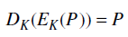
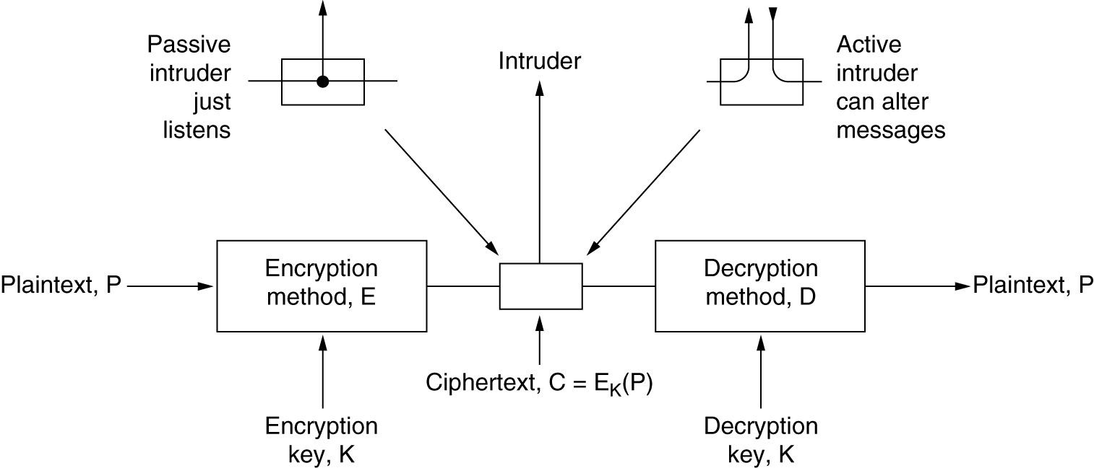
An Introduction to Cryptography
The encryption model (for a symmetric-key cipher).

Slide 3
Kerckhoff’s principle
All algorithms must be public; only the keys are secret

Slide 4
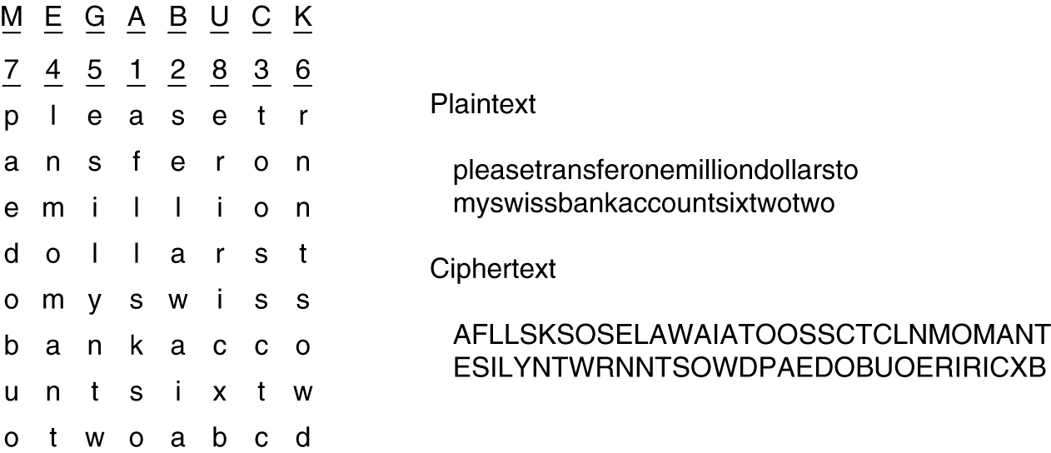
Substitution & Transposition Ciphers
Example – Caesar Cipher, Monoalphabetic Substitution Cipher
Example - Columnar transposition cipher.

Slide 5
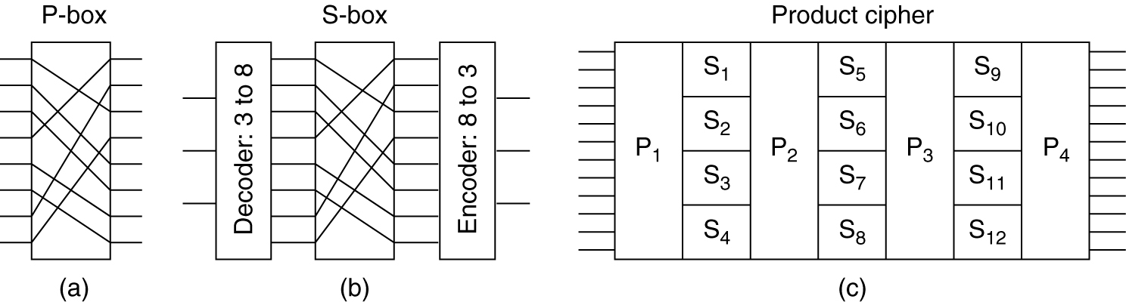
Product Ciphers
Basic elements of product ciphers.
(a) P-box. (b) S-box. (c) Product.

Slide 6
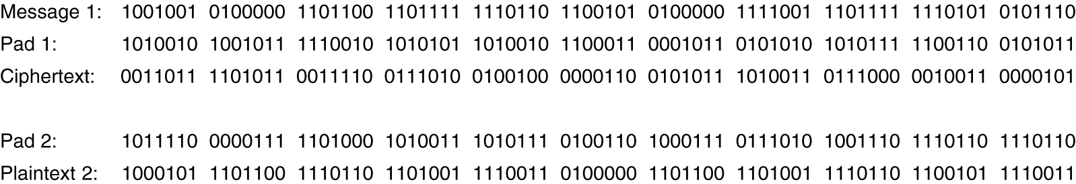
One-Time Pads
The use of a one-time pad for encryption and the possibility of getting any possible plaintext from the ciphertext by the use of some other pad.

Slide 7
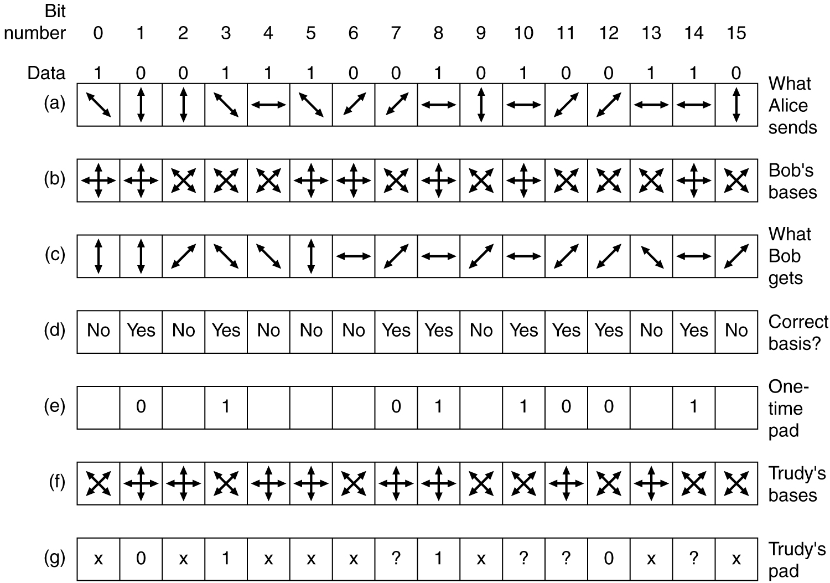
Quantum Cryptography
An example of quantum cryptography.

Slide 8
Two fundamental principles
Redundancy
Freshness

Slide 9
Symmetric-Key Algorithms
DES – The Data Encryption Standard
AES – The Advanced Encryption Standard

Slide 10
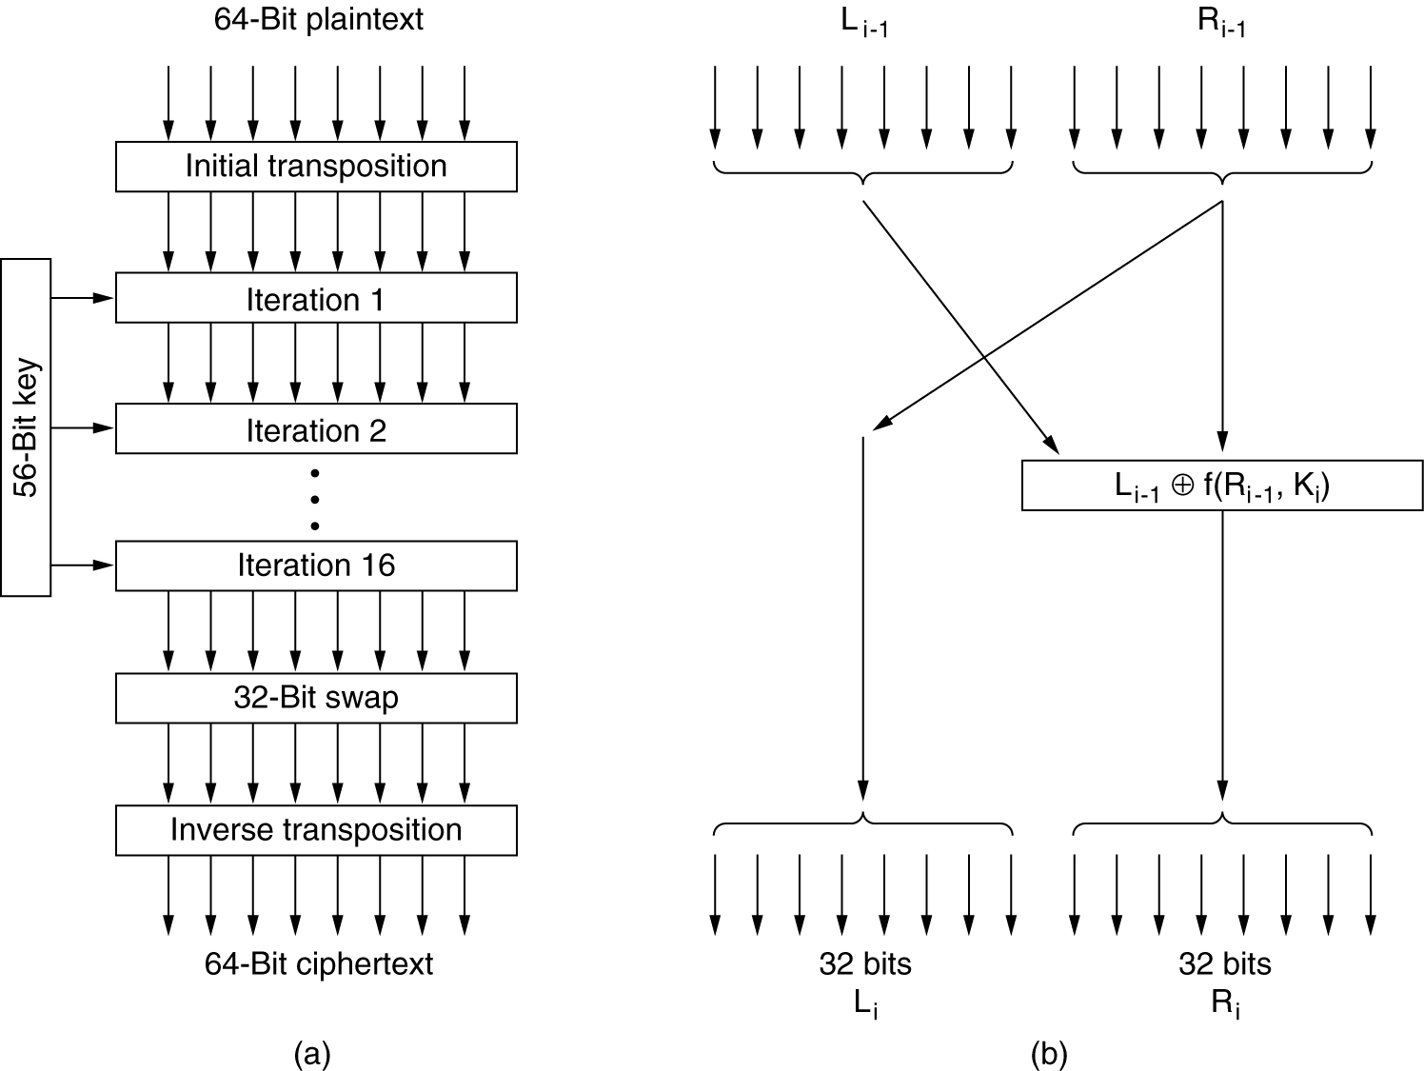
Data Encryption Standard
The data encryption standard.
General outline.
Detail of one iteration.

Slide 11
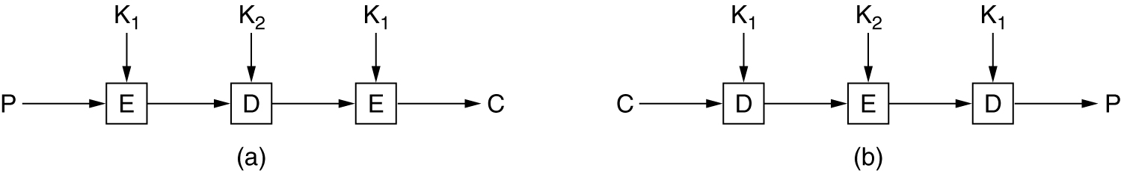
Triple DES
(a) Triple encryption using DES. (b) Decryption.

Slide 12
AES – The Advanced Encryption Standard
Rules for AES proposals
The algorithm must be a symmetric block cipher.
The full design must be public.
Key lengths of 128, 192, and 256 bits supported.
Both software and hardware implementations required
The algorithm must be public or licensed on nondiscriminatory terms.

Slide 13
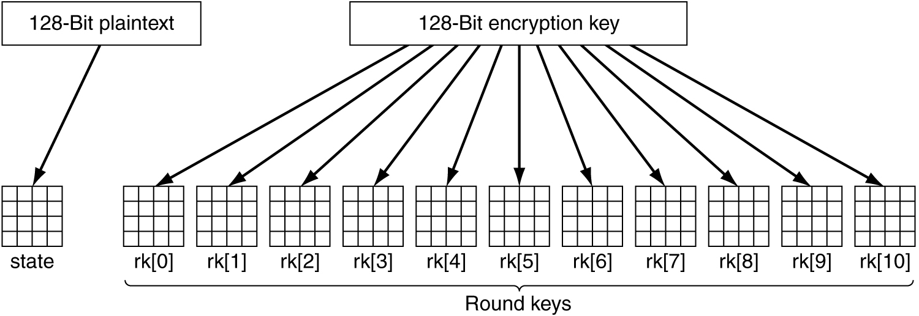
AES
Creating of the state and rk arrays.

Slide 14
CIPHER Modes

Slide 15
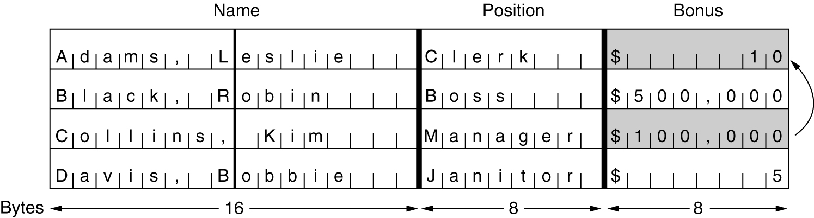
Electronic Code Book Mode
The plaintext of a file encrypted as 16 DES blocks.

Slide 16
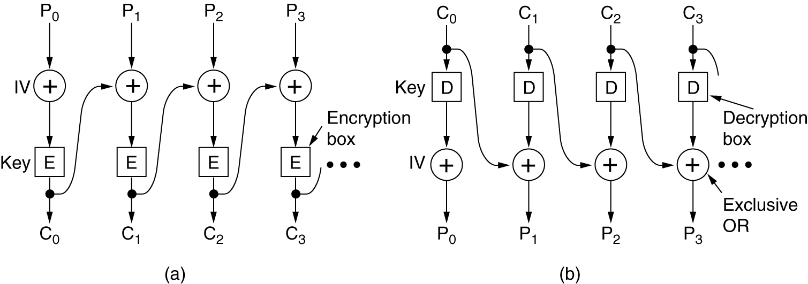
Cipher Block Chaining Mode
Cipher block chaining.
(a) Encryption. (b) Decryption.

Slide 17
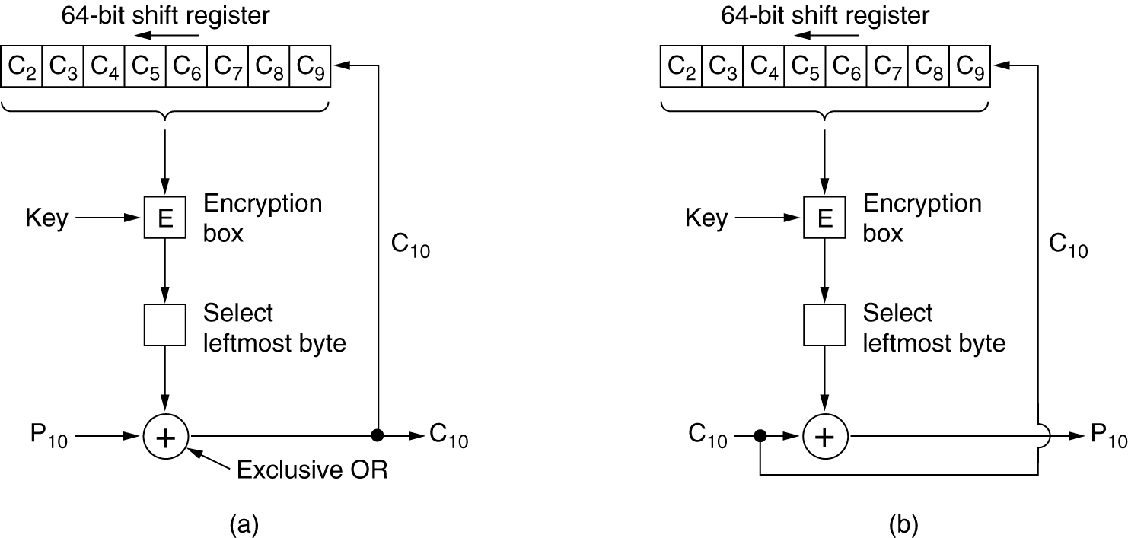
Cipher Feedback Mode

Slide 18
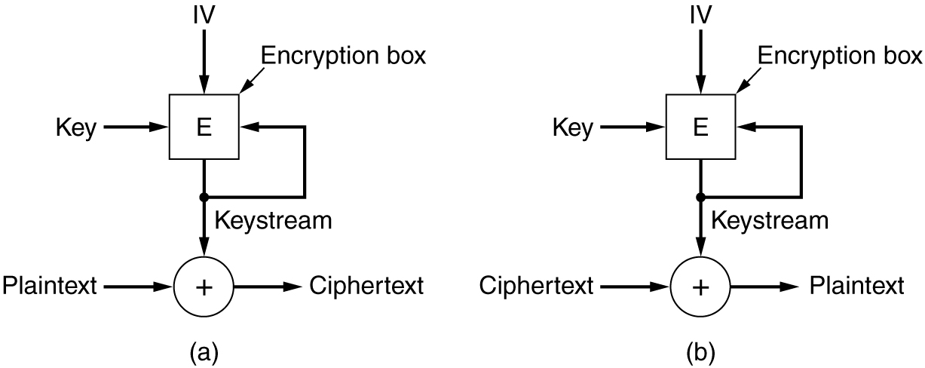
Stream Cipher Mode
A stream cipher.
(a) Encryption. (b) Decryption.

Slide 19
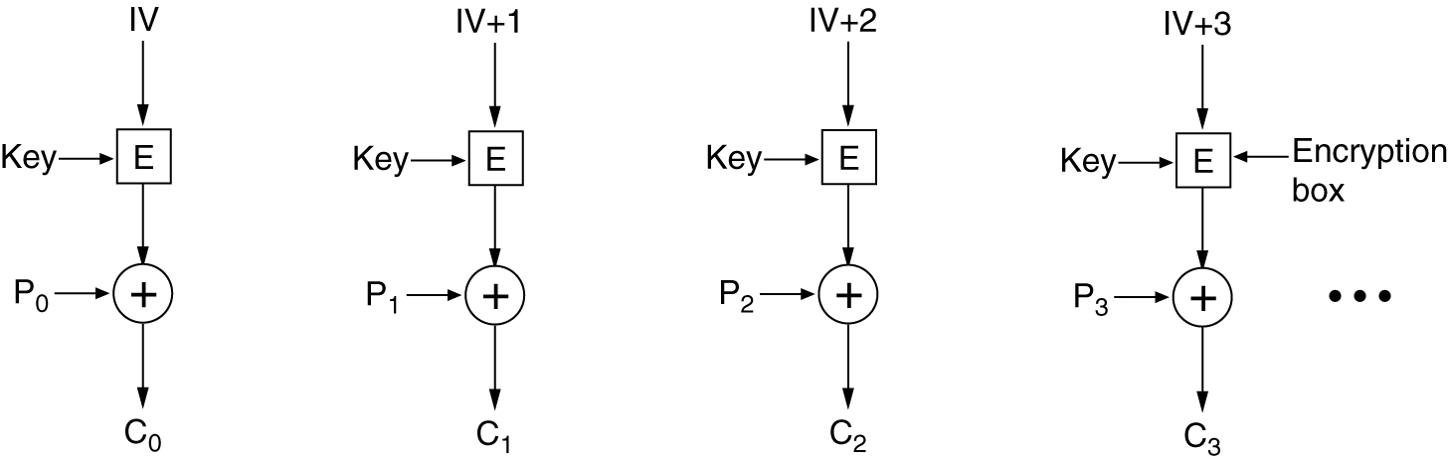
Counter Mode
Encryption using counter mode.

Slide 20
Public-Key Algorithms - RSA

Slide 21
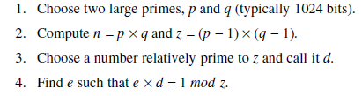
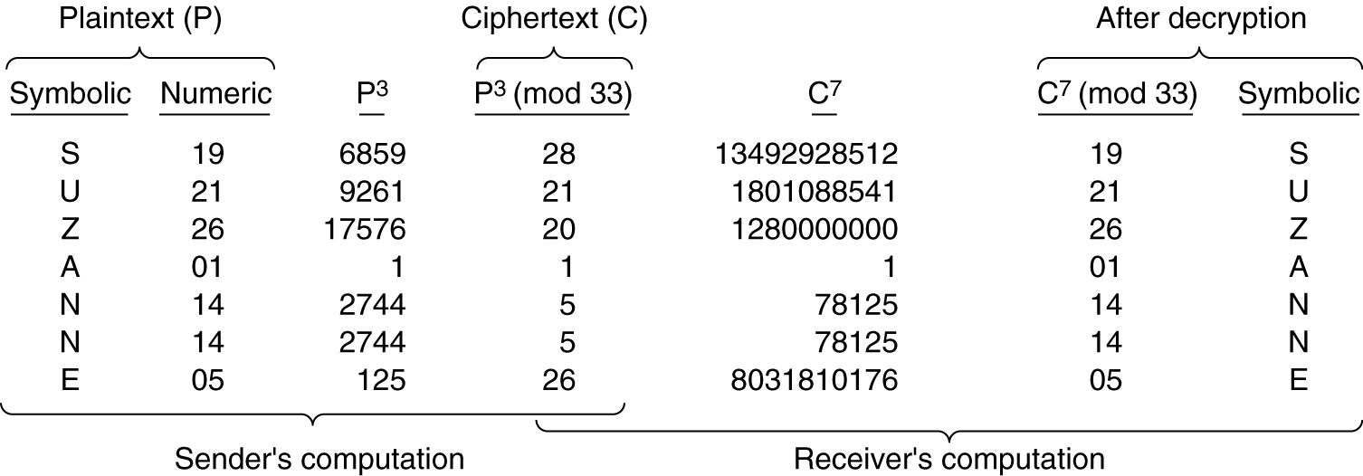
RSA
An example of the RSA algorithm.

Slide 22
Digital signature

Slide 23
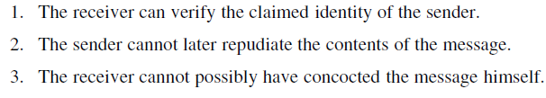
Digital Signatures – conditions

Slide 24
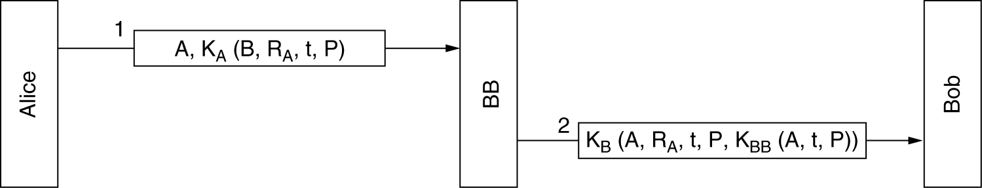
Symmetric-Key Signatures
Digital signatures with Big Brother.

Slide 25
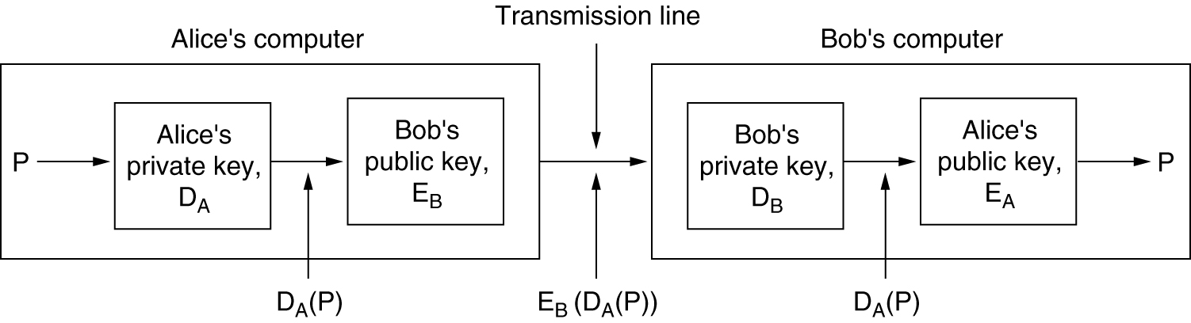
Public-Key Signatures
Digital signatures using public-key cryptography.

Slide 26
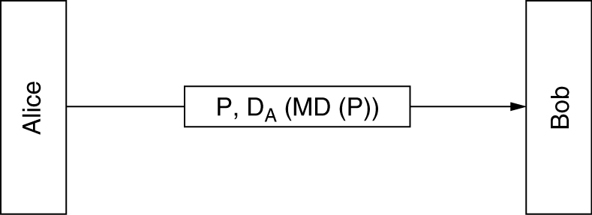
Message Digests
Digital signatures using message digests.

Slide 27
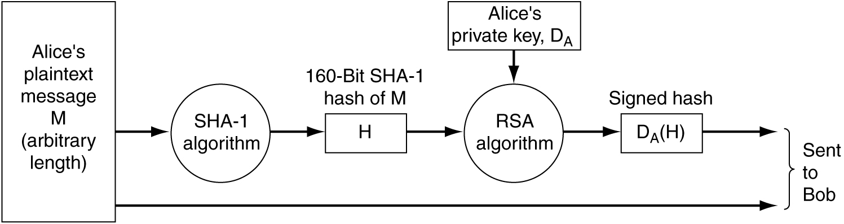
SHA-1
Use of SHA-1 and RSA for signing nonsecret messages.

Slide 28
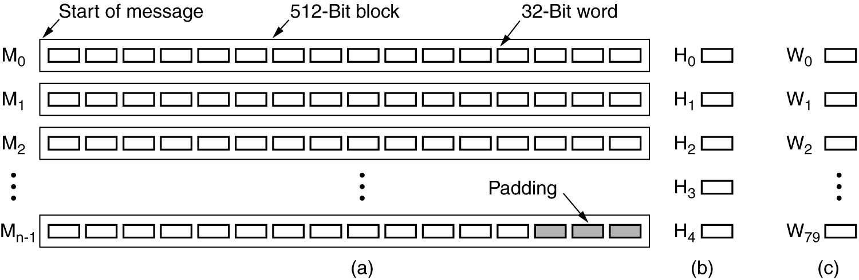
SHA-1 (2)
(a) A message padded out to a multiple of 512 bits.
(b) The output variables. (c) The word array.

Slide 29
Communication Security
IPsec
Firewalls
Virtual Private Networks
Wireless Security

Slide 30
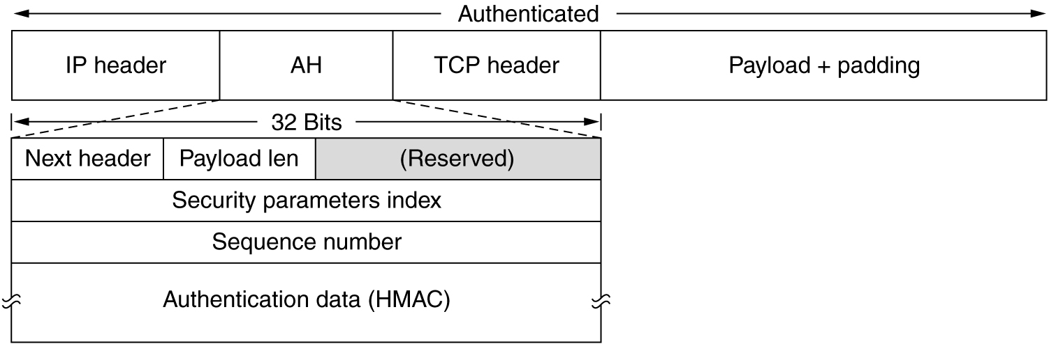
IPsec
The IPsec authentication header in transport mode for IPv4.

Slide 31
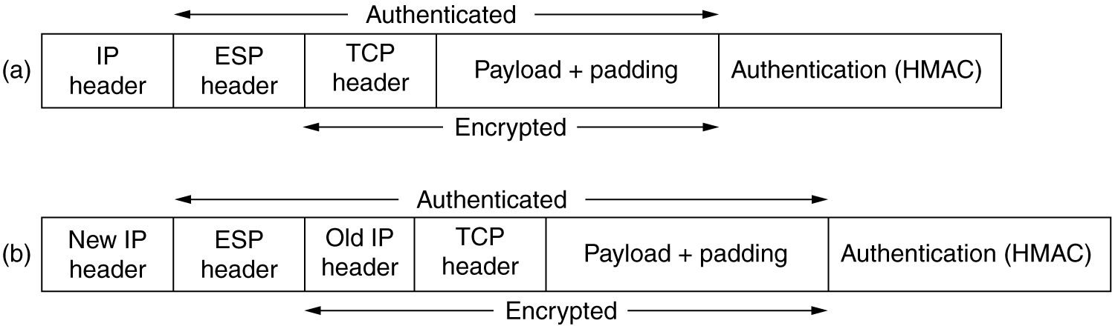
IPsec
(a) ESP in transport mode. (b) ESP in tunnel mode.

Slide 32
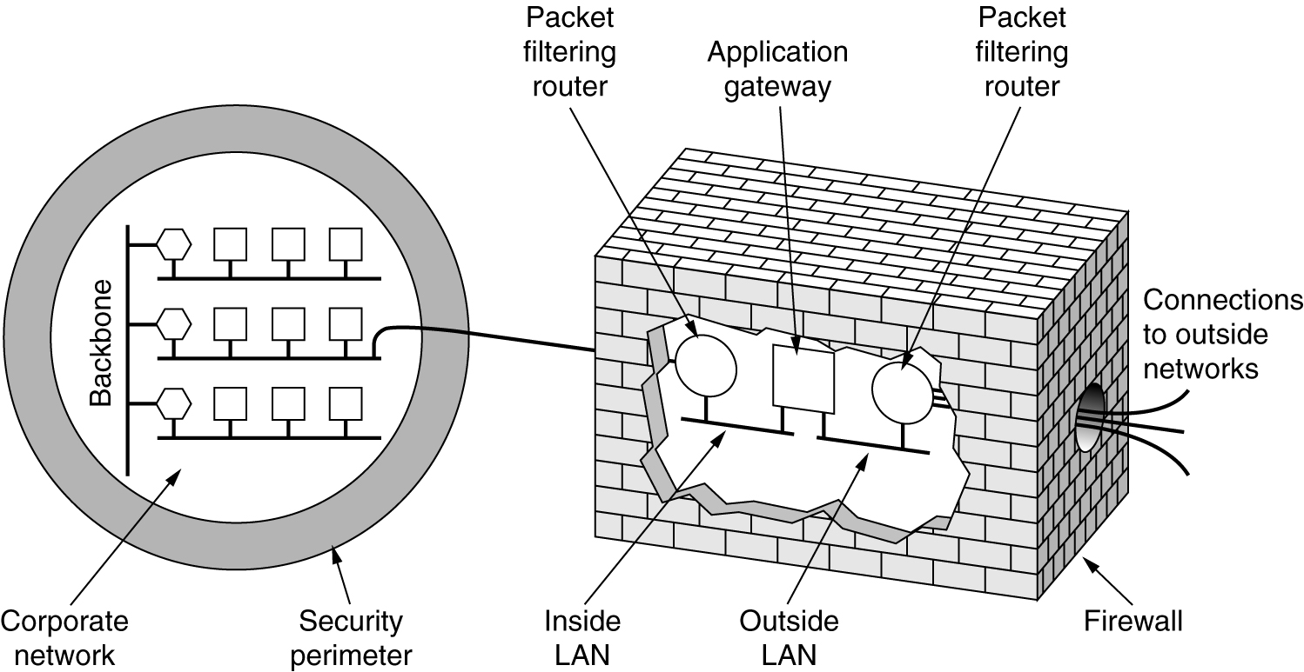
Firewalls
A firewall consisting of two packet filters and an application gateway.

Slide 33
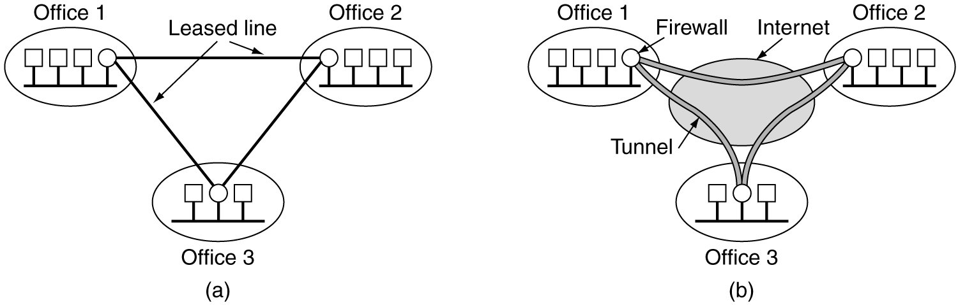
Virtual Private Networks
(a) A leased-line private network. (b) A virtual private network.

Slide 34
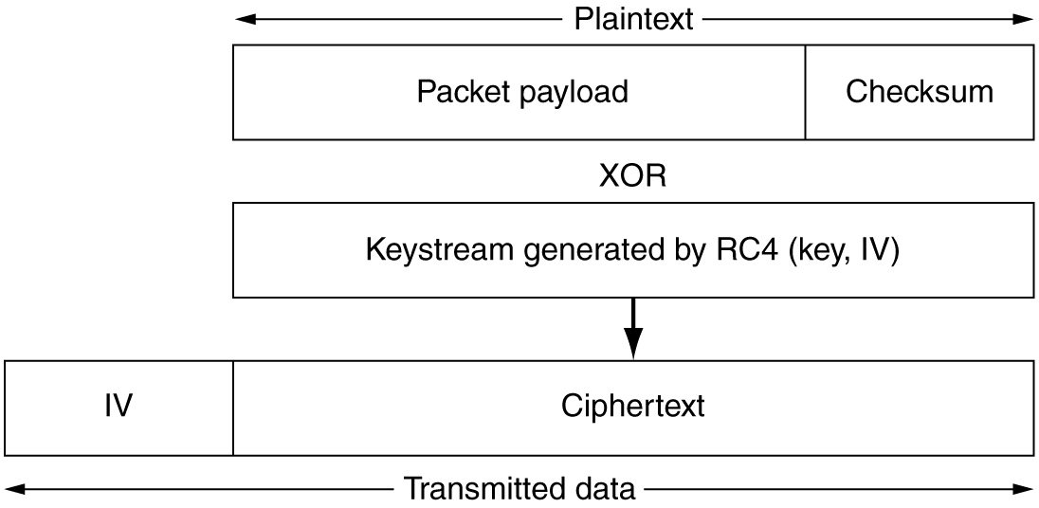
802.11 Security
Packet encryption using WEP.

Slide 35
Authentication Protocols
Authentication Based on a Shared Secret Key
Establishing a Shared Key: Diffie-Hellman
Authentication Using a Key Distribution Center
Authentication Using Kerberos
Authentication Using Public-Key Cryptography

Slide 36
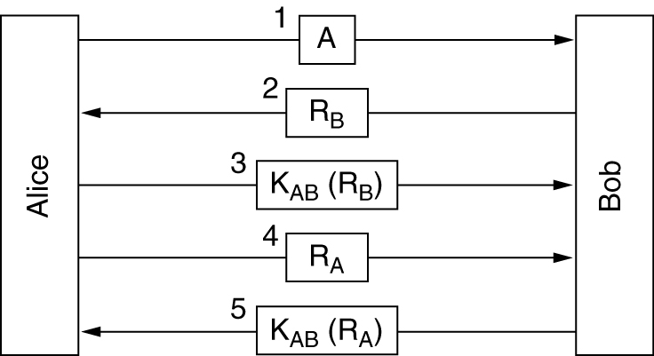
Authentication Based on a Shared Secret Key (1)
Two-way authentication using a challenge-response protocol.

Slide 37
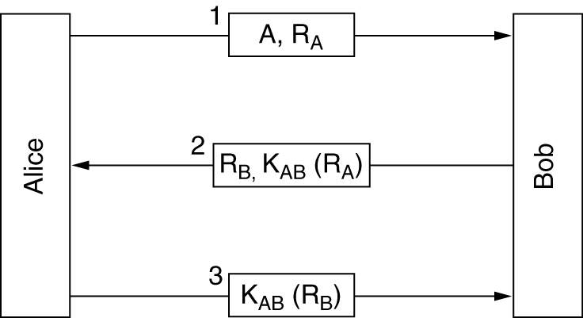
Authentication Based on a Shared Secret Key (2)
A shortened two-way authentication protocol.

Slide 38
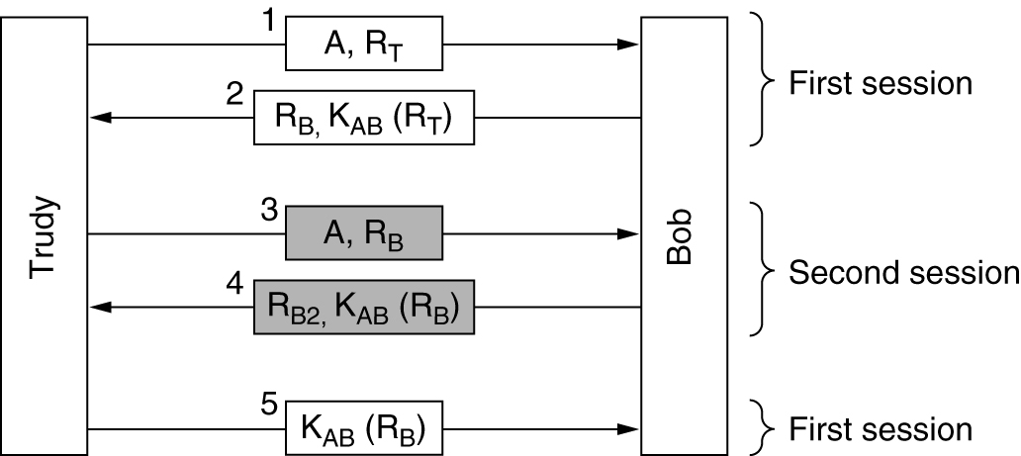
Authentication Based on a Shared Secret Key (3)
The reflection attack.

Slide 39
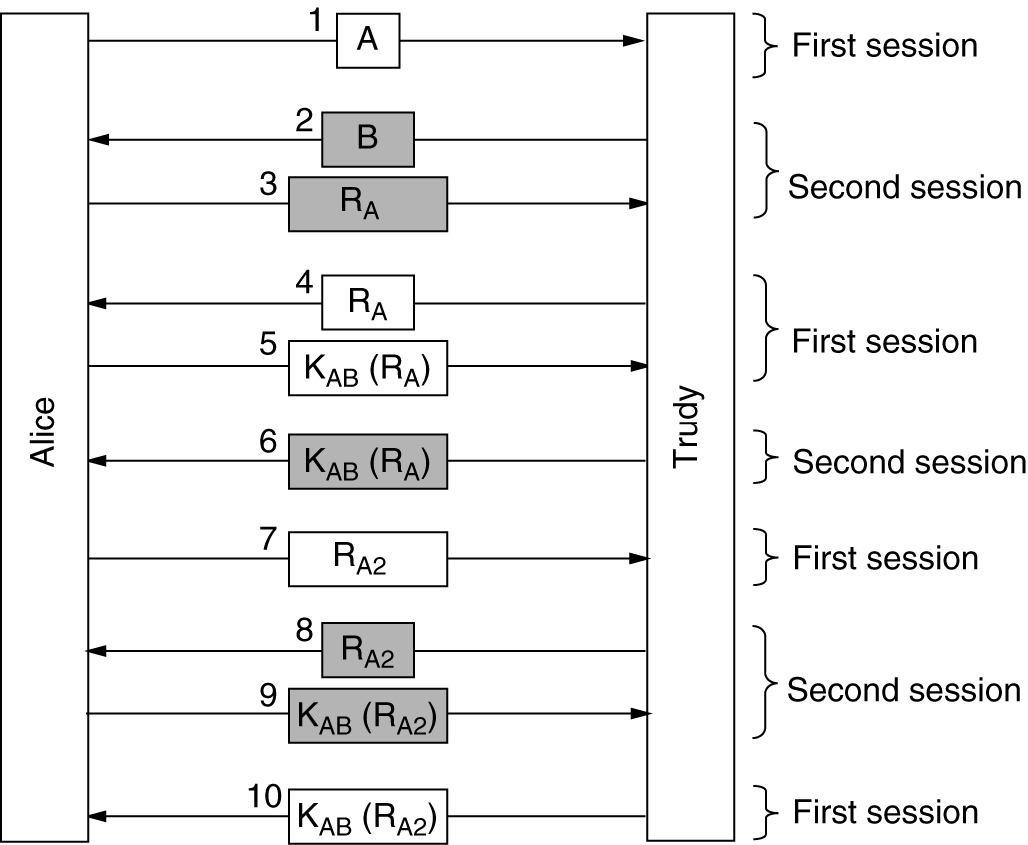
Authentication Based on a Shared Secret Key (4)
A reflection attack on the protocol of Fig. 8-32

Slide 40
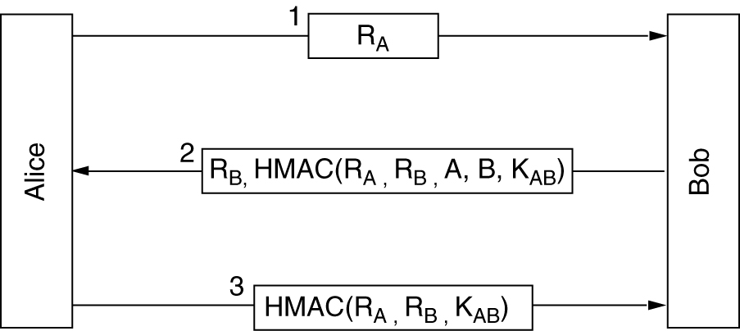
Authentication Based on a Shared Secret Key (5)
Authentication using HMACs.

Slide 41
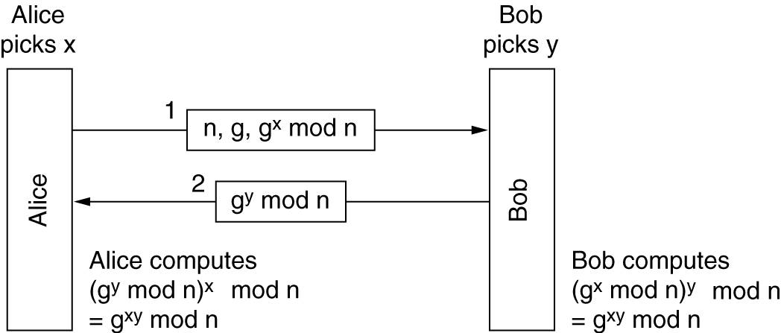
Establishing a Shared Key: The Diffie-Hellman Key Exchange
The Diffie-Hellman key exchange.

Slide 42
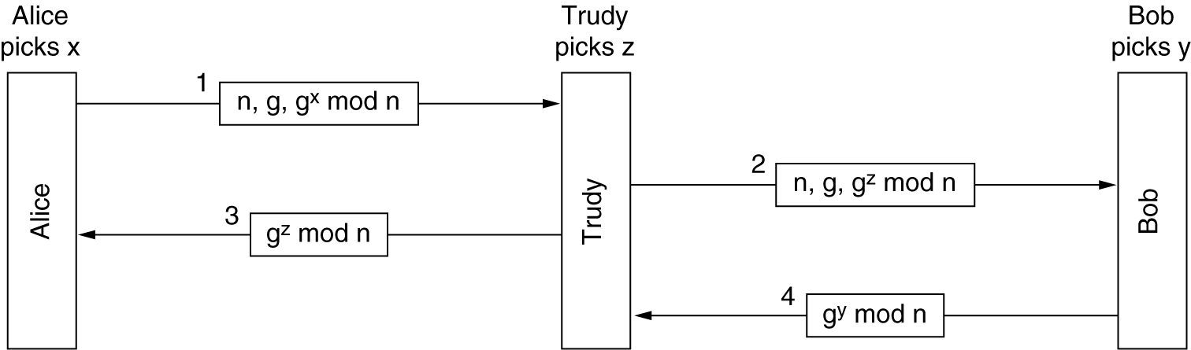
Establishing a Shared Key: The Diffie-Hellman Key Exchange
The bucket brigade or man-in-the-middle attack.

Slide 43
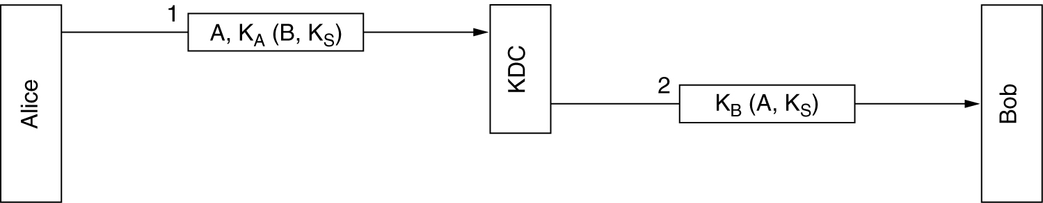
Authentication Using a Key Distribution Center
A first attempt at an authentication protocol using a KDC.

Slide 44
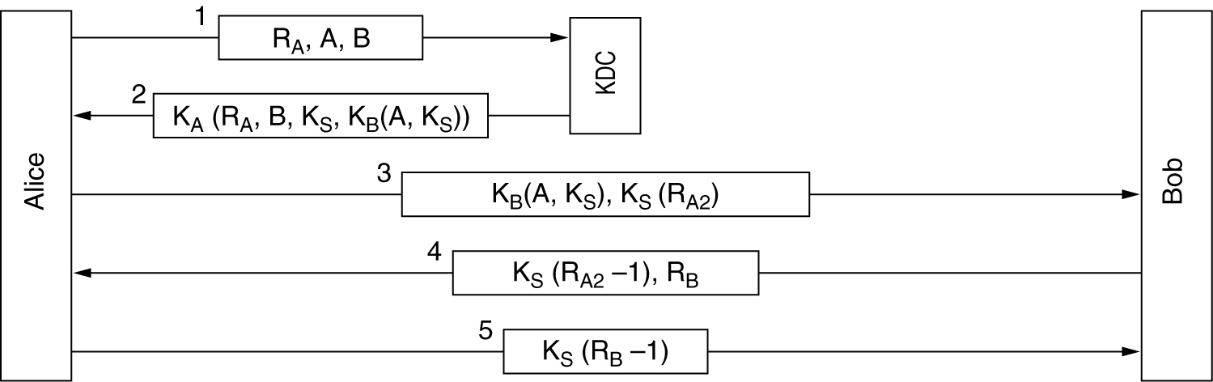
Authentication Using a Key Distribution Center (2)
The Needham-Schroeder authentication protocol.

Slide 45
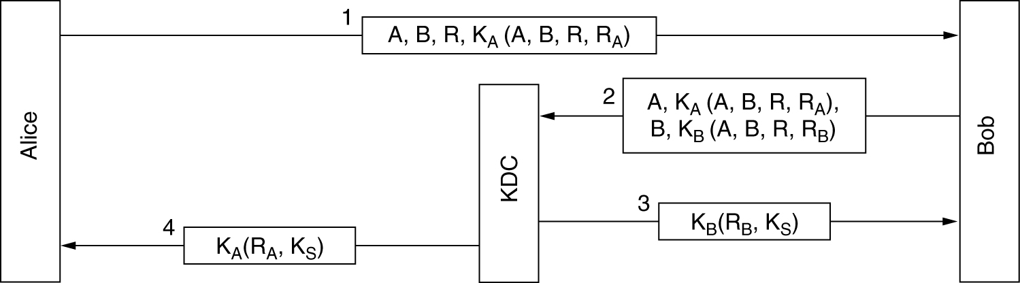
Authentication Using a Key Distribution Center (3)
The Otway-Rees authentication protocol (slightly simplified).

Slide 46
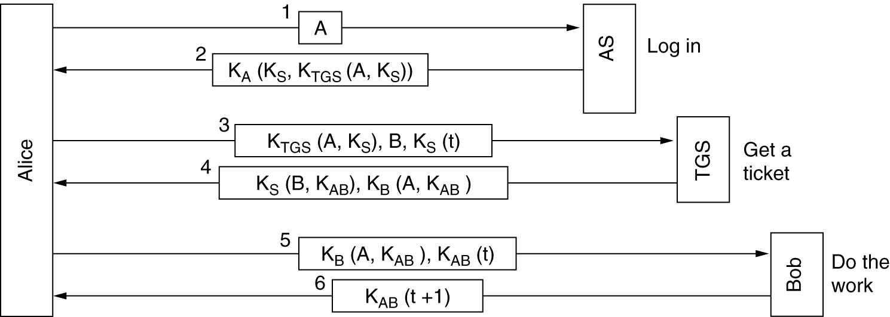
Authentication Using Kerberos
The operation of Kerberos V4.

Slide 47
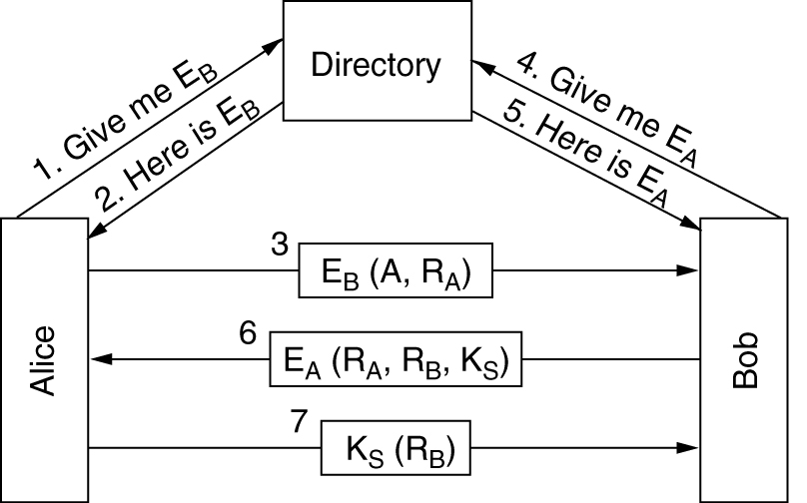
Authentication Using Public-Key Cryptography
Mutual authentication using public-key cryptography.

